Slide 1
Introduction to GPELab
LI Xiaoke
2015.05.02

Slide 2
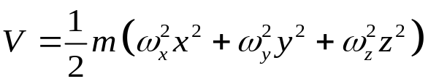
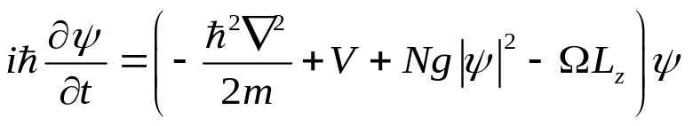
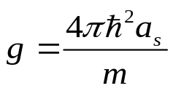

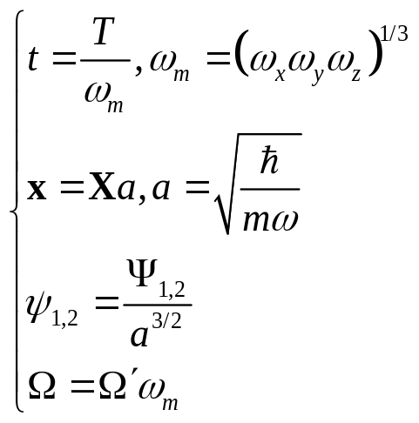
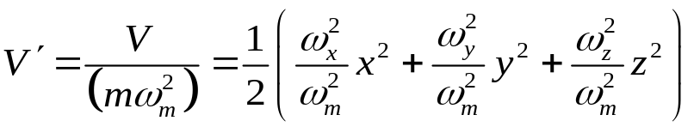
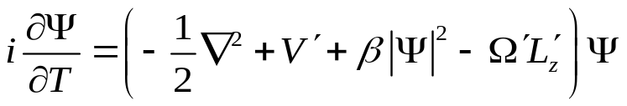
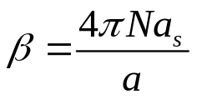

The dimensionless GPE
Transformation

Slide 3
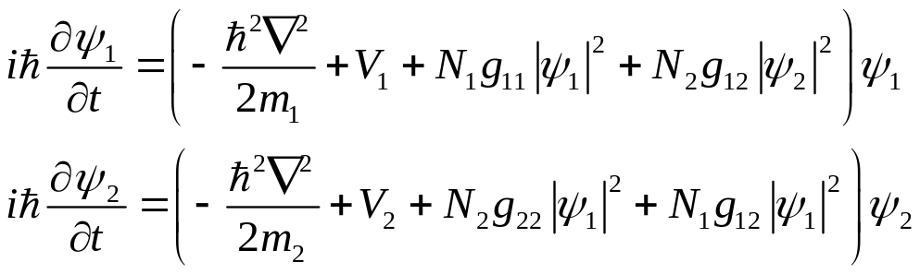
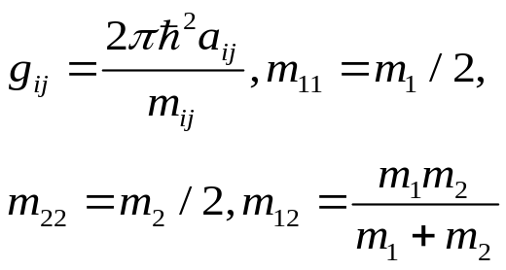
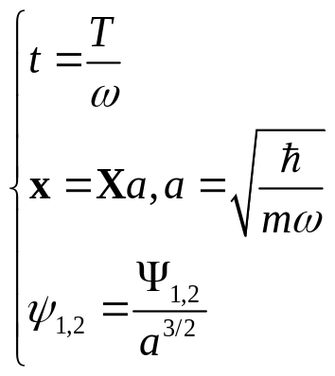
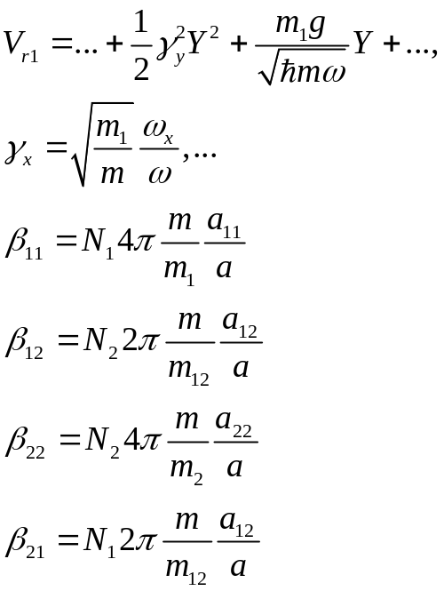
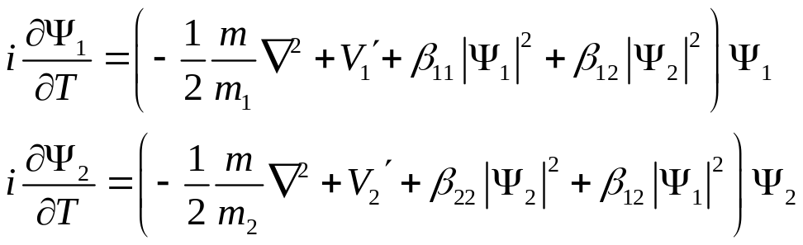
Two components
Transformation

Slide 4
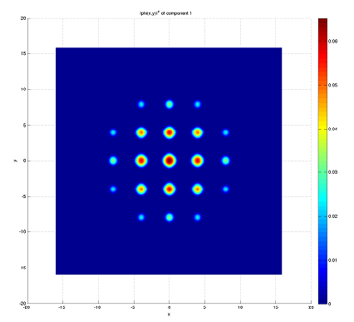
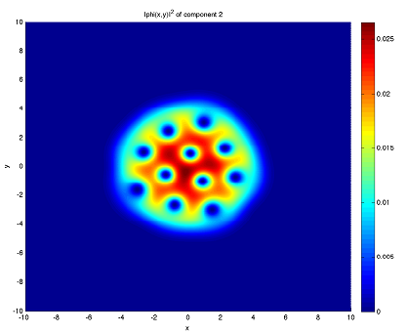
GPELab
a matlab toolbox
can solve the stationary dynamical solutions of GPE
can solve 1D, 2D, and 3D problems
can solve multicomponents GPE
easy to use
Example of physical problems:
BEC in a harmonic trap and expansion
Rotating BEC, vortices
General potential (double well, optical lattice, ...)
BEC with dipole-dipole interaction
Solition
spinor BEC
spin-orbit coupled BEC
...

Slide 5
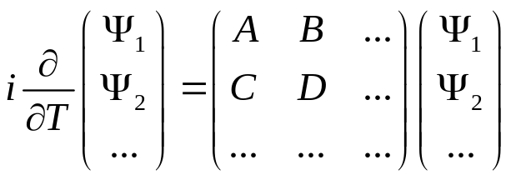
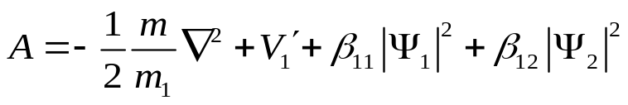

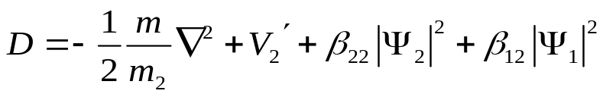

The equation in general solved in GPELab:
TBEC is a special case:

Slide 6
Numerical method
Basis: Imaginary time method (or projected gradient method)
Discretization:
Time: Backward Euler time approximation (BE)
Space: Spectral scheme based on FFT (SP)
Others: Crank-Nicolson approximation scheme, Second-order finite difference scheme, ...

Slide 7
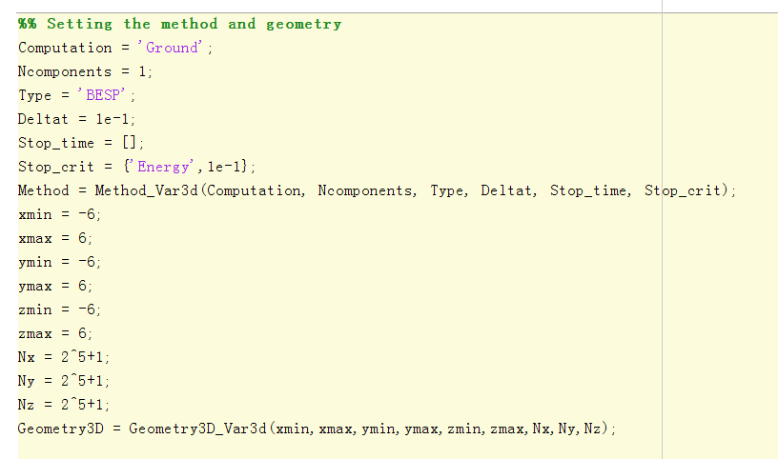
Procedure of a calculation:

Slide 8
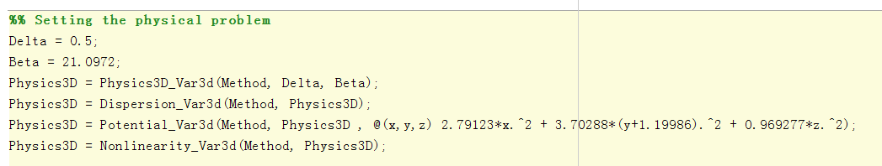
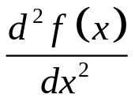

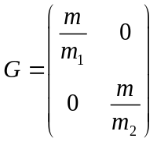
FT
Changing the dispersion:

Slide 9
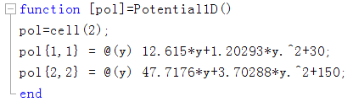
Defining the potential:
2 components case
(1) Define a cell, with the potential function in the elements
(2) Apply the Potential_varXD function
In dynamic calculation, need TimePotential

Slide 10
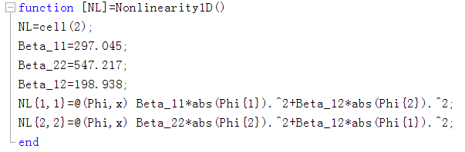
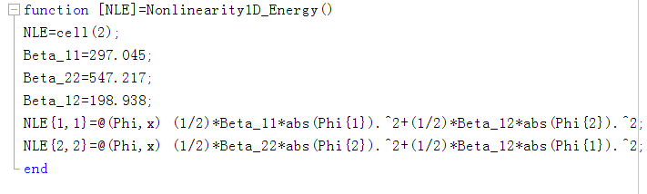
Defining the nonlinearity term
(1) Define a cell, with the nolinearity function in the elements
(2) Define a cell, with the nolinear energy in the elements
(3) Apply the Nonlinearity_varXD function

Slide 11
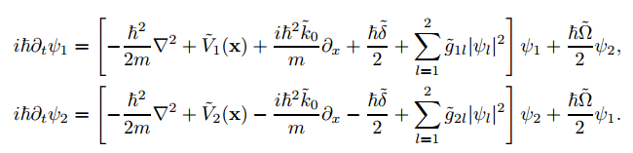
When do we need the nondiagonal elements?
when B, C≠0

Slide 12
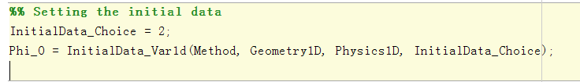
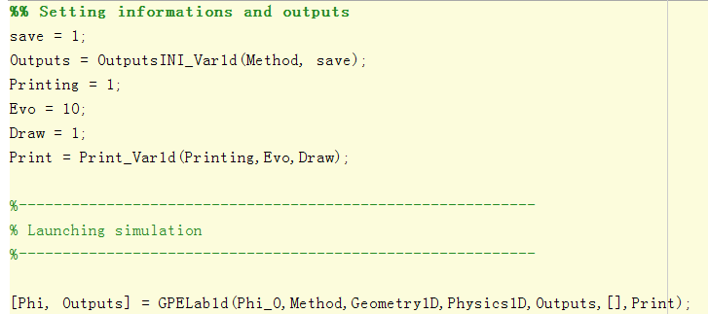

Slide 13
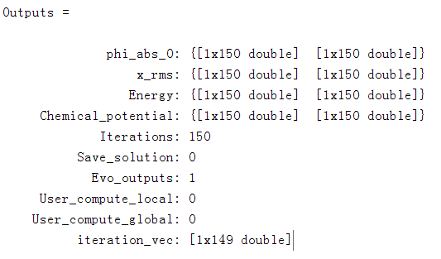
The outputs:
Phi is a cell contains the wavefunction (3D matrix)
Phi{1}, Phi{2}
Outputs is a structure contains the informations

Slide 14
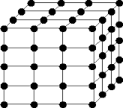
Dealing with 3D matrix in 3D calculation
The wavefunction, x coordinate, y coordinate
and z coordinate are all 3D matrices.
Calculation of columndensity, center of mass,
...
A few functions are written

Slide 15
The difficulty
Matrix memory: 40M
Calculation Memory: 1.5G
in 3D calculation, Nx=Ny=Nz=2^7+1
Nx=Ny=Nz=2^8+1
Matrix memory: 300M
Nx=Ny=Nz=2^9+1
Matrix memory: 2.3G
size of region of tof:intrap~10:1
Strategy: Intrap 2^5+1 (in 28um), exapnd the solution to 2^7+1 (in 114um)
tof 2^7+1, can calculate to t=6ms
(reduce to 2^6+1 and expand to 2^7+1, should get 228um)
ExpandMatrix
ReduceMatrix

